Slide 1
Muon

Slide 2
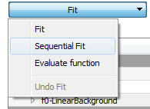
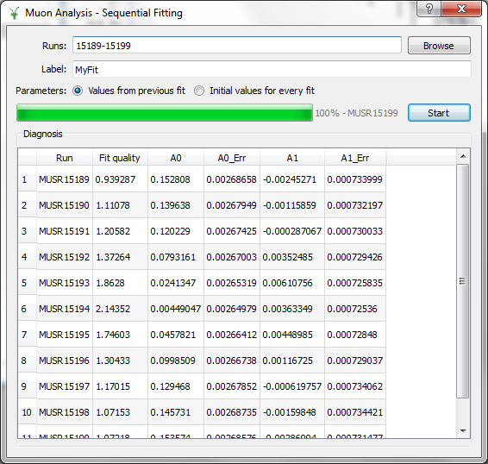
Muon – Sequential fitting

Slide 3
Muon – Workflow
New workflow algorithms
MuonCalculateAsymmetry
MuonLoad
Data structure for grouping
Returned from LoadMuonNexus
MuonGroupDetectors
LoadMuonNexus returns dead times as a table

Slide 4
Muon – Various improvements
Plot positioning
Re-using plot window
More run information parameters read
Sample temperature
Sample magnetic field
Bugfixes
Mostly plotting issues

